Slide 1
Master Thesis
Data-Driven Failure Detection in a Charging Communication
Arav Barot

Slide 2



Overview of the Thesis
1. Overview of thesis
To carry out the exploratory analysis, to find out useful knowledge from the Raw data
Data consist of KPIs during the charging process of an EV and Charging sessions
To use Machine Learning Algorithm and Statistical methods to cluster data with similar charging behavior and environment
Notes:
Kind of a One pager, That mainly tells about the thesis with least words possible

Slide 3
Agenda of the Meeting
Weekly Update – calendar week 47
1. | Timeline
2. | The Landscape of the Thesis
3.

Slide 4
Agenda of the Meeting
Weekly Update – calendar week 47
1. | Timeline of the Thesis
2. | The Landscape of the Thesis
3.

Slide 5
Timeline of the Thesis
1.Timeline of the thesis
July
Start of the Thesis
Onboarding & Setup
August
In-depth Study of the Charging Infrastructure
September
October
November
December
January
Documentation of Results
Introduction to the Field
Understanding Capstone data
Quality check and improvement of data
Exploratory analysis of the data
Identification of the Problem Statement
Development of Clustering Algorithms
Testing and Tuning of Clustering algorithms
Comparison of algorithm outputs
LBA Data Matching
Measurements of CT images of different Battery cell
Development of Random forest algorithm
Written work of Thesis
Access to the latest PCA data
Important feature analysis
Adaptation of Clustering algorithm to the new data
Adaptation of Random forest to the new data
Optimization of the Random forest algorithm
Written work of Thesis
2023
2024
Supporting Tasks

Slide 6

Why new Methodology
Previously discussed points (review)
Previously Discussed points
Requirement to find out complex correlation between Error points and features.
Automated sorting of upcoming data points with current clusters as per different charging behaviour.
Try to find out interdependancies of features of the data frame.
Requirement for new Analysis Method
As clustering algorithm groups similar type of datapoints, clusters needs to me interpreted manually to derive a useful conclusion.
It is difficult to make hypothesis regarding complex relation of required class (Error1,Error2,Error3) with features (power, duration, temperature) with clustering and PCA.
Therefore a method which can directly provide an information about correlation of targeted class and feature should be implemented

Slide 7
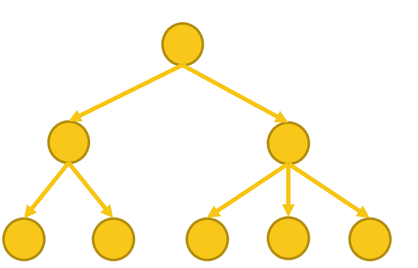
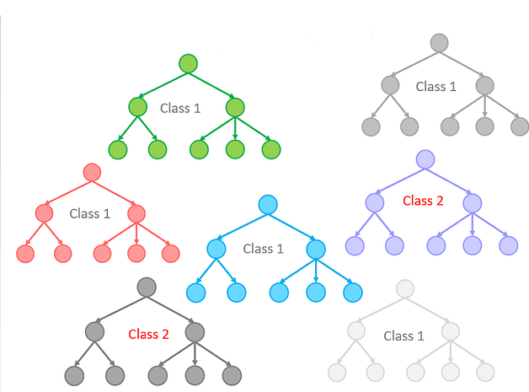
Random Forest Algorithm
Previously discussed points (review)
Description
The Algorithm is a supervised machine learning algorithm, made of several decision trees which take features as an input and classify the targeted output.
Decision tree
Benefits
Each node of Random forest algorithm is traceable.
Traceability feature allows to find out significance of features with respected output class.
Easier to track accuracy of an algorithm
Random Forest
Use Case in this Thesis
To find out the most significant features which causes an error.

Slide 8
Methodology
Previously discussed points (review)
Prepare data (Determine Target class)
Split data into test train and internal validation
Tune Hyperparameters of Algorithm
Train Decision tree and check accuracy
Derive Most significant features

Slide 9
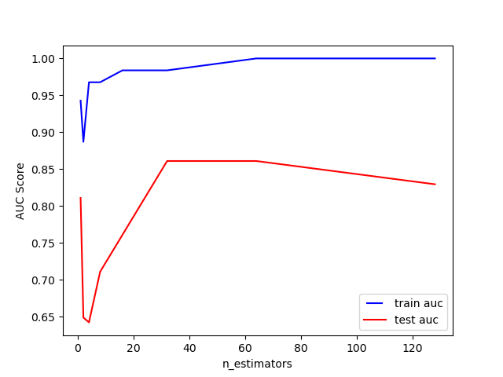
Example output for Error 2 (error_ladeabbruch)
Previously discussed points (review)
Description
In this algorithm output class is set to error 2 whether it is True or False.
Train and test accuracy is measured with different numbers of decision trees to check which one has more accurate test results. And the random forest is trained with 32 estimator trees.
In the next step Most significant features which has major influence on output decision are traced.
After Training the algorithm, it is tested on the previously unseen dataset.
Key findings
Most Significant parameters influencing output of Error 2
Charging Session Duration
Maxbmsdynladestrom
Durationpluggingcharging
SOCHUB
Max_bms_ist_vorlauf_temperature
CPO
The Blue line represents the accuracy of algorithm during training and The Red line shows an accuracy during the test.

Slide 10
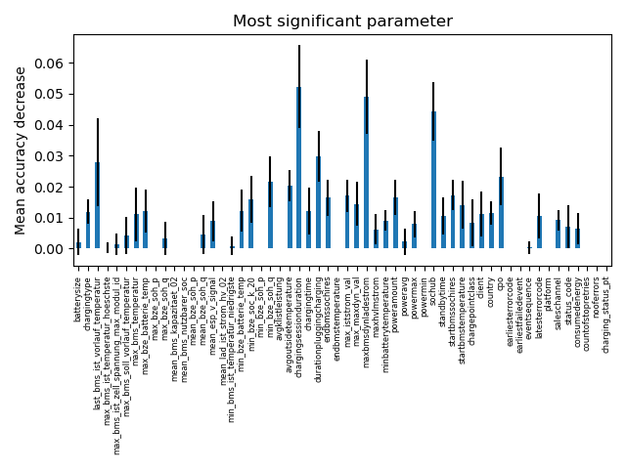
Most significant parameters for Error 2
Previously discussed points (review)
Method used to plot
To obtain this plot the Feature permutation methodology is used.
Once random forest is built, the algorithm shuffles random features.
Features which have created the most influence for obtaining a correct results are plotted with high values on a bar plot.

Slide 11
Agenda of the Meeting
Weekly Update – calendar week 47
1. | Previously discussed points (Review)
2. | Hyperparameters and Data selection
3. | Results of Random forest

Slide 12
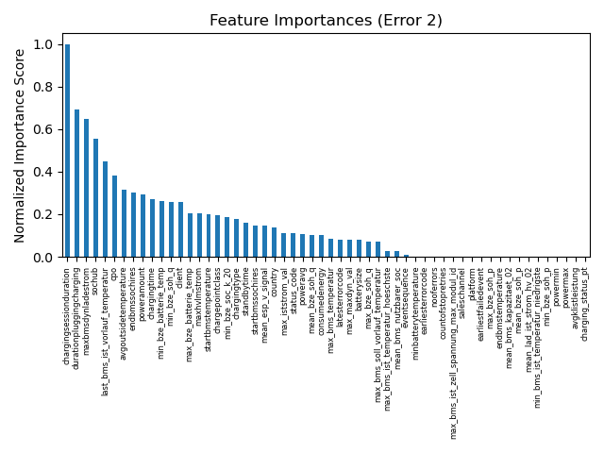
Initial Results from Standard Hyperparameters
Hyper parameters and feature selection
Hyperparameters
Numbers of Estimators 32
Selection criteria - Max AUC score on text dataset
Bootstraping, Out of the bag (OBB) Validation, Warmstart are On.
Method of Feature Tracing
Features in this method are traced by using Permutation Importance method.
Number of iterations – 100

Slide 13
Agenda of the Meeting
Weekly Update – calendar week 47
1. | Previously discussed points (Review)
2. | Hyperparameters and Data selection
3. | Results of Random forest

Slide 14
Error 2 -
Results from random forest
Hyperparameters
Numbers of Estimators 32
Selection criteria - Max AUC score on text dataset
Bootstraping, Out of the bag (OBB) Validation, Warmstart are On.
Method of Feature Tracing
Features in this method are traced by using Permutation Importance method.
Number of iterations – 100

